Slide 1
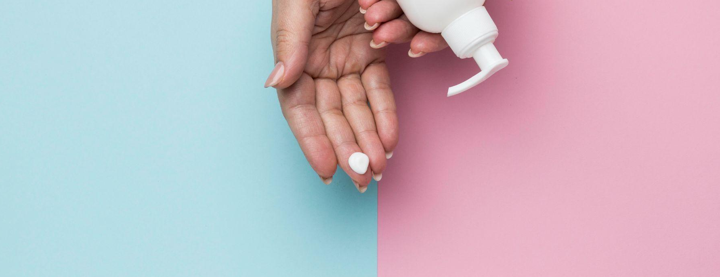

ShampYou:
A Personalized Shampoo Recommender
Dameli Aziken, Twinkle Panda, Vishwa Patel, Sneha Sastry Rayadurgam, Kimberly Simmonds

Slide 2
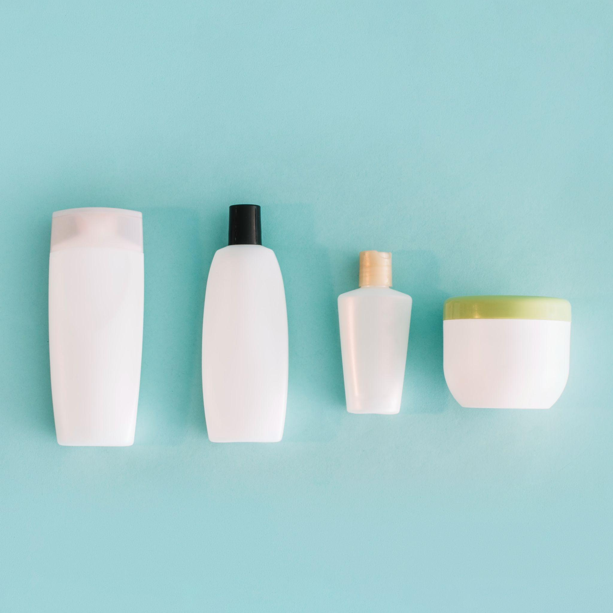
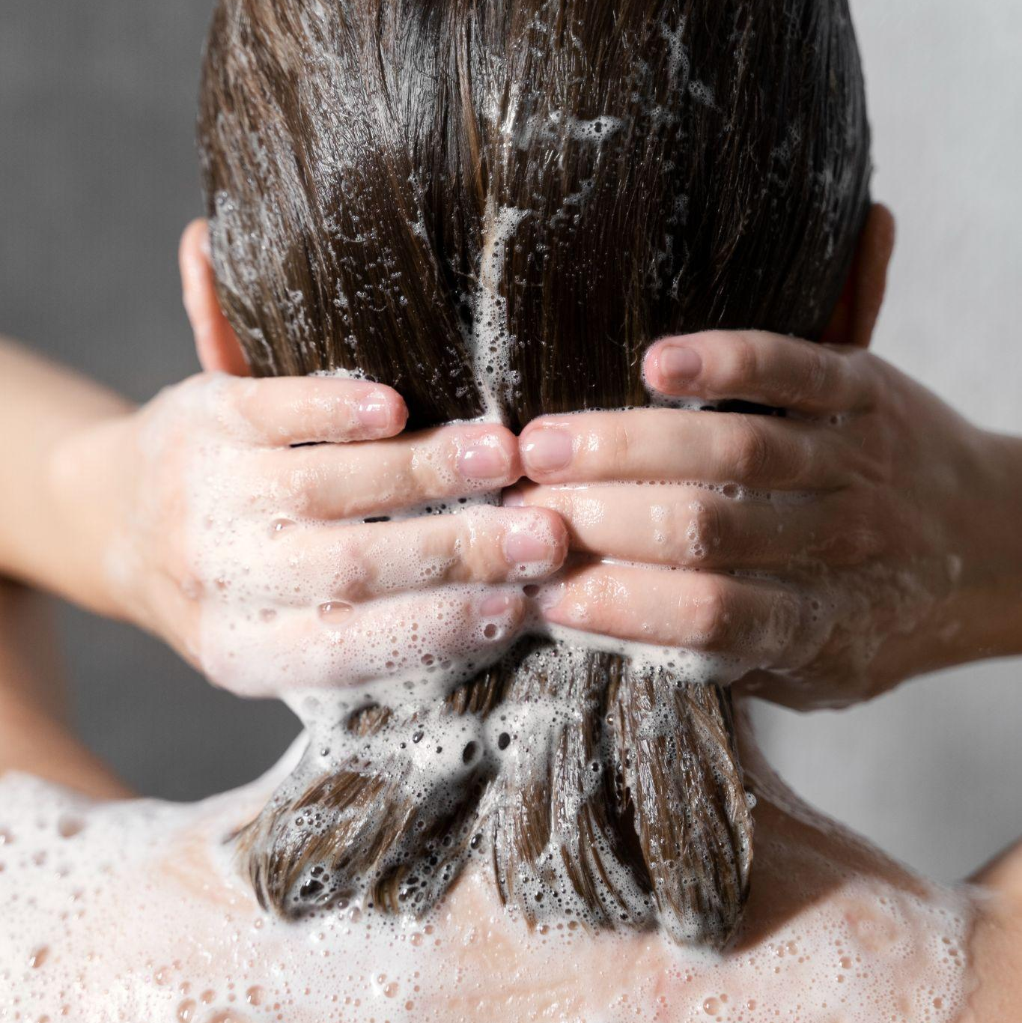
Untangling the Problem
As of Oct 2024, Influenster.com has over 22,000 products in the shampoo category. How should we choose one?
By number of sales/popularity? …But even popular products have unhappy customers
By product description? …But product marketing =/= customer perception

Slide 3






Data Sources
For the top 100 shampoos, we extracted:
total review count and
average rating
50 most recent ratings
and reviews
But something is missing…what if our user wants to find a more affordable alternative?
10,000 product prices →
fuzzy match to Influenster

Slide 4
Our Analysis Process
Review Translation | Translate all foreign language reviews (many in German, Chinese, Spanish) into English
Word Frequency | Perform a frequency count of the unique words in reviews
Product Popularity | Investigate if the long-tail effect exists, based on the number of reviews per product
Lift for Attributes | Find top attributes and compare their lift values and find the co-mentions between them
Cosine Similarity & Vader Sentiment | Use Vader and Cosine similarity analysis to get recommended shampoos by particular attribute(s) - average it out by grouping at a product level
Spacy Similarity & Vader Sentiment | Use spaCy and Vader to compute an overall score and find the average overall score for each product.
Recommendation | Improve user recommendations through use of additional price data
Notes:
from deep_translator import GoogleTranslator
from langdetect import detect

Slide 5
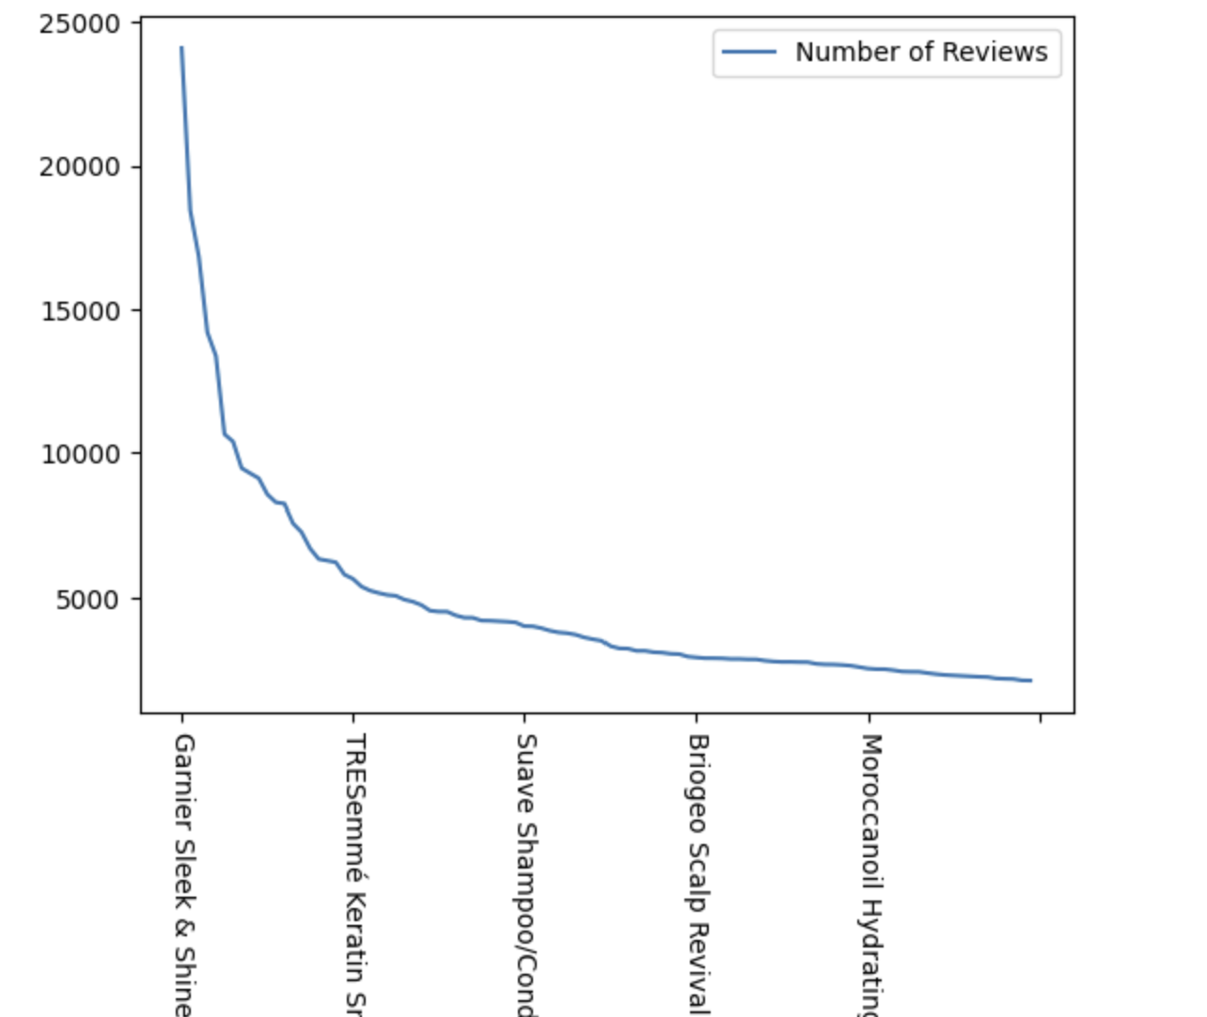
How Do You Choose?
Most consumers will pick the most popular products. But what if there is a suitable alternative in the long-tail?
We used number of reviews as a proxy for unit sales.

Slide 6
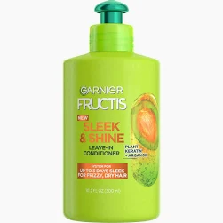
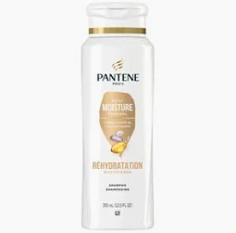
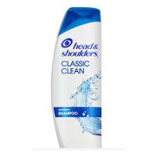
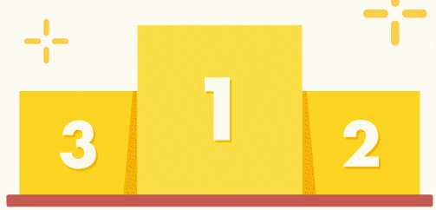

Trusting the popularity
Garnier Sleek & Shine Intensely Smooth 4.41
Head & Shoulders Classic Clean Anti-Dandruff Shampoo 4.22
Pantene Daily Moisture Renewal Shampoo 4.26

Slide 7
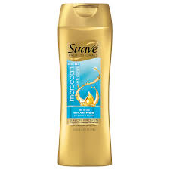
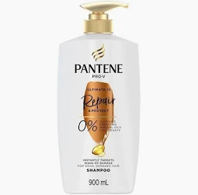
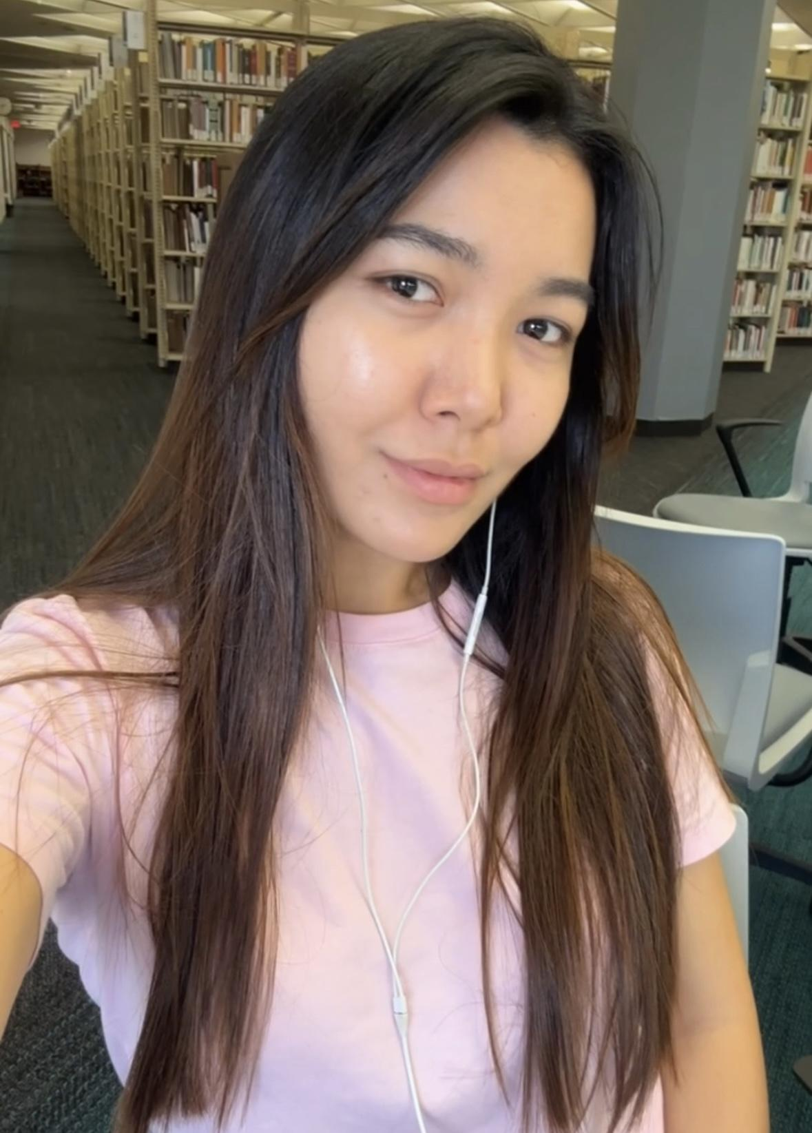
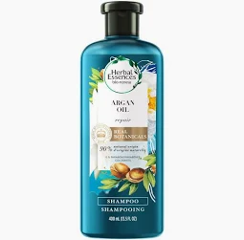
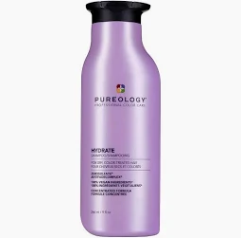
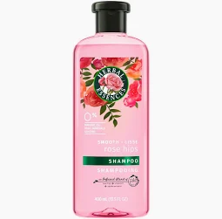
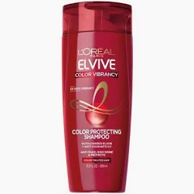
Profile 1: Soft, Shiny, Silky
Cosine similarity
Suave Moroccan Infusion Shine Shampoo $ 4.43
Pantene Pro-V Ultimate 10 Shampoo $ 7.01
Herbal Essences Argan Oil of Morocco Shampoo
$ 10.95
spaCy similarity
Pureology Hydrate Shampoo $ 75.95
Herbal Essences Smooth Collection Shampoo
$15.99
L’Oreal Paris Color Vibrancy Intensive Protecting Shampoo
$ 4.99

Slide 8
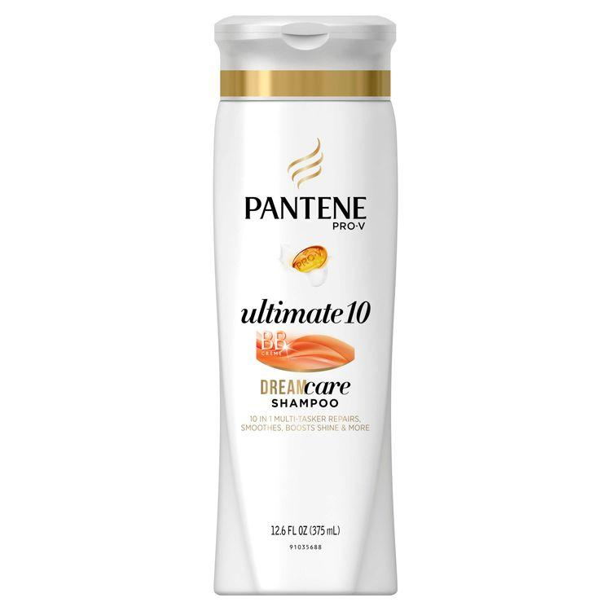
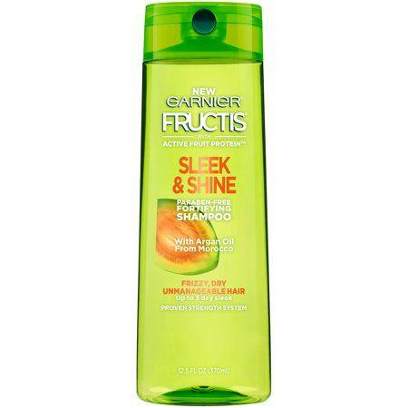
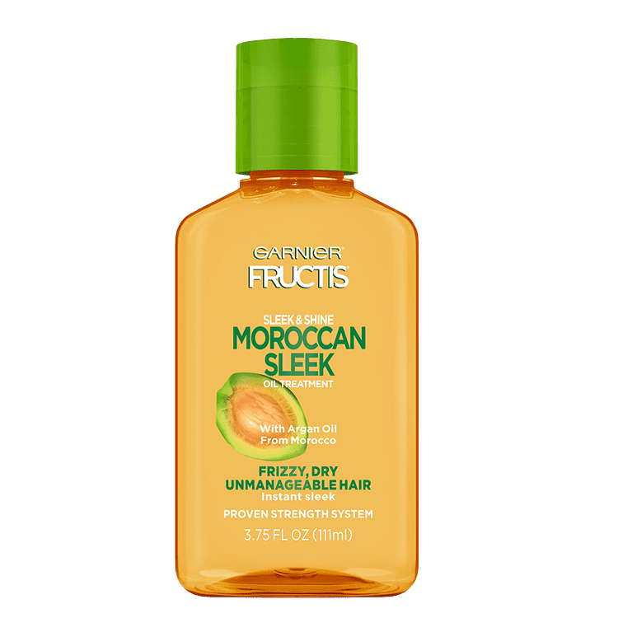
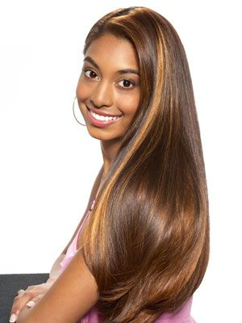
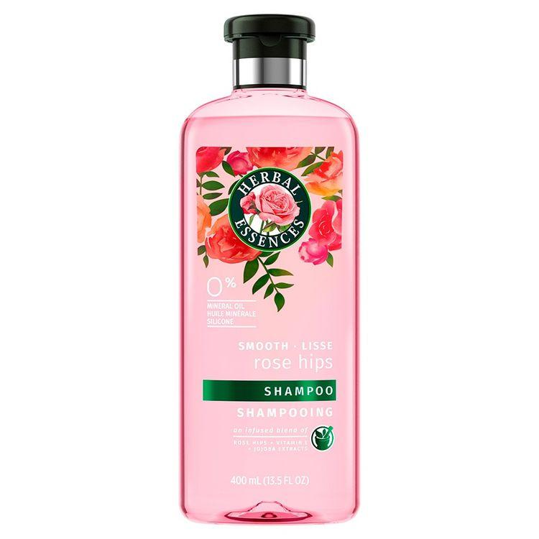
Profile 2: Frizz-Free, Shiny, Affordable
Cosine similarity
Pantene Pro-V Ultimate 10 Shampoo $ 7.01
Garnier Sleek & Shine Shampoo $ 5.99
Garnier Sleek & Shine Moroccan Sleek Oil Treatment
$ 25.95
spaCy similarity
Herbal Essences Smooth Collection Shampoo
$ 15.99
Pureology Hydrate Shampoo $ 17.95
Garnier Sleek & Shine Shampoo $ 5.99

Slide 9
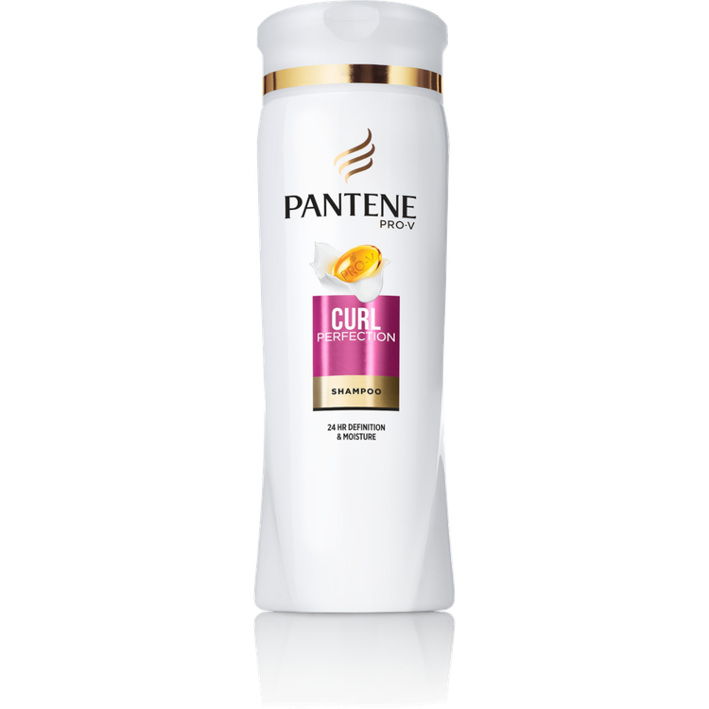
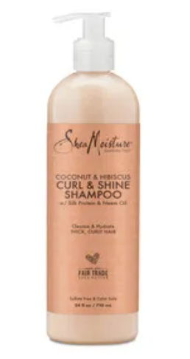
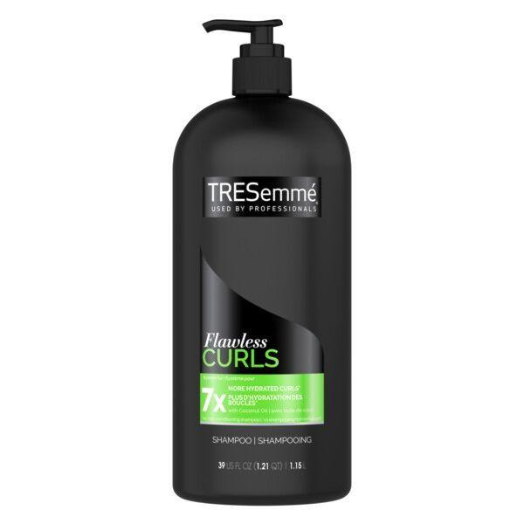
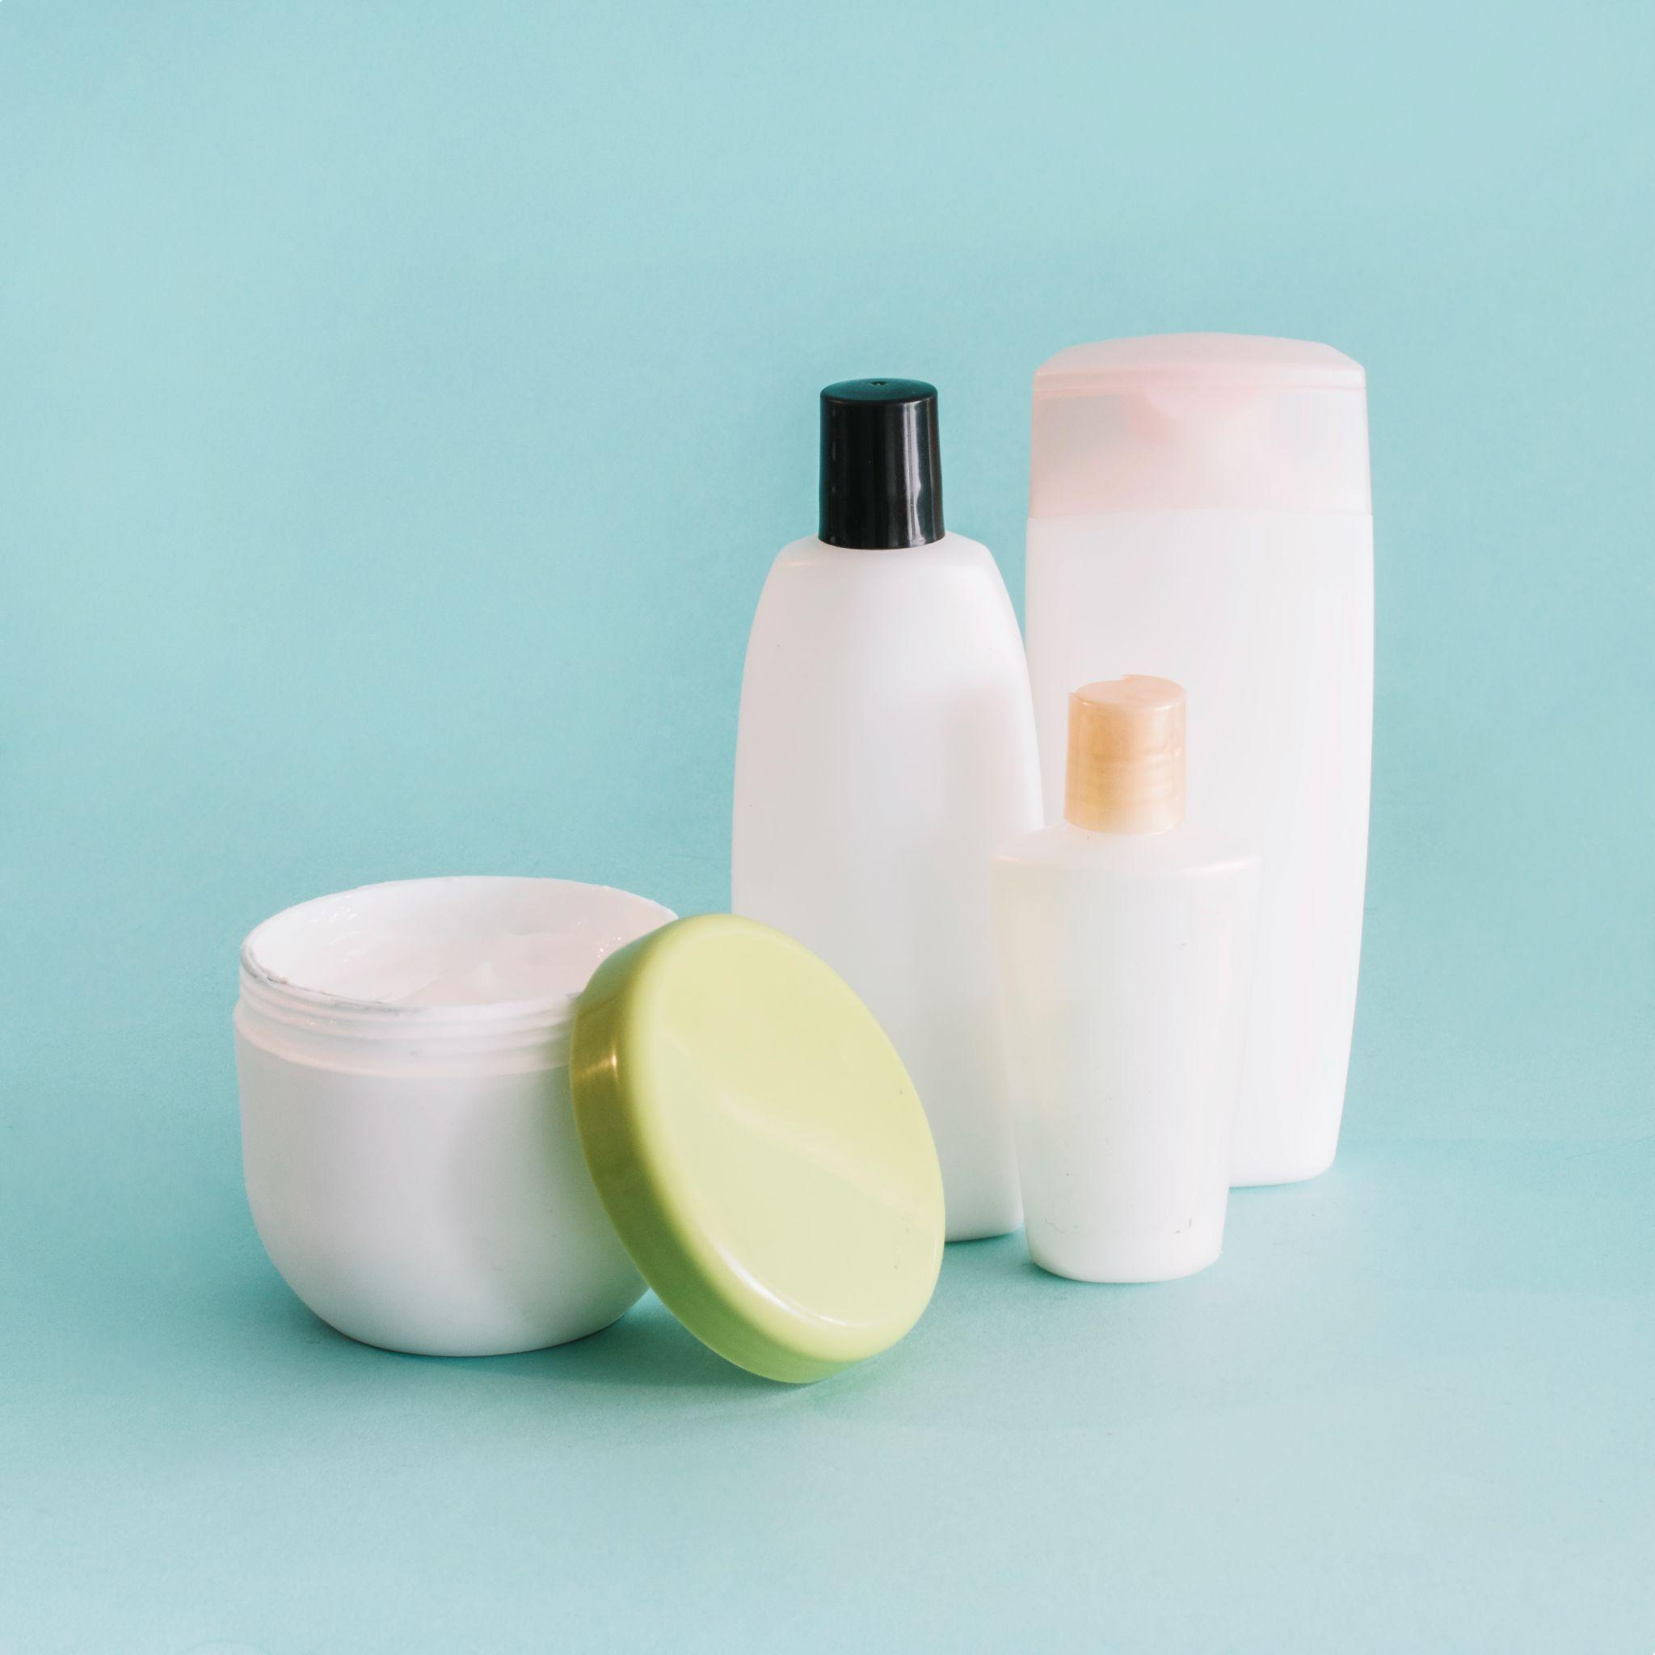
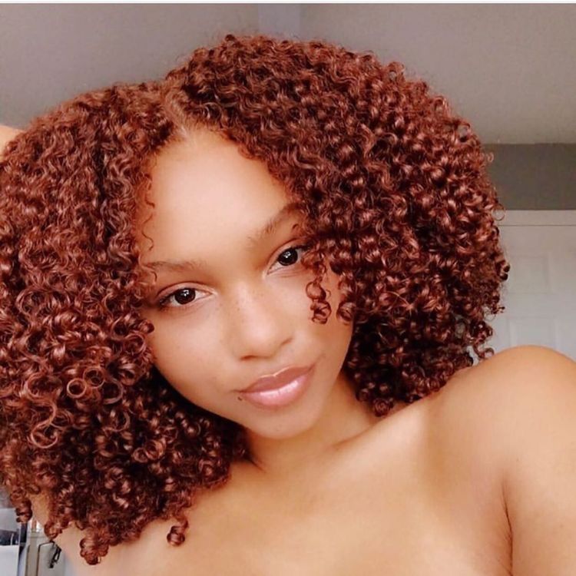
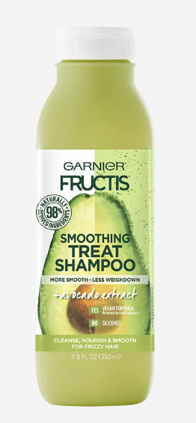
Profile 3: Curly, Nourishing, Fruity
Cosine similarity
Pantene Curl Perfection Shampoo $ 18.99
Coconut & Hibiscus Curl & Shine Shampoo $ 80.92
Tresemme Flawless Curls Shampoo with Coconut Oil
$ 10.55
spaCy similarity
Herbal Essences Smooth Collection Shampoo
$ 15.99
Pureology Hydrate Shampoo $ 75.95
Garnier Smoothing Treat 1 Minute Hair Mask + Avocado Extract $ 80.92

Slide 10
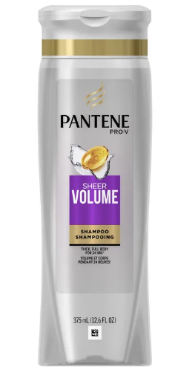
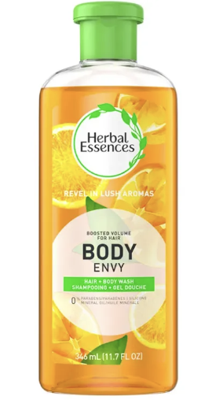
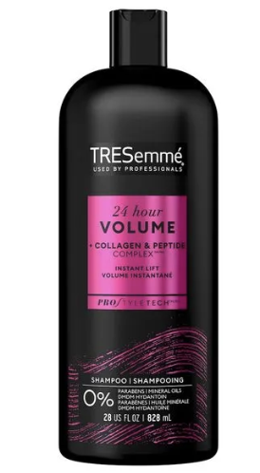
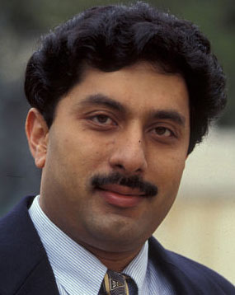
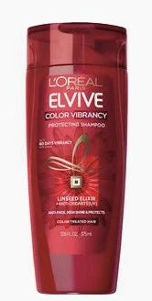
Profile 4: Herbal, Hydration, Volume
Cosine similarity
Pantene Sheer Volume Shampoo $ 12.47
Herbal Essences Body Envy Volumizing
Shampoo $11.15
Tresemme 24 Hour Volumizing Shampoo
for Fine Hair $ 80.92
spaCy similarity
Herbal Essences Smooth Collection Shampoo $ 15.99
Garnier Sleek & Shine Shampoo $ 5.99
L’Oreal Paris Color Vibrancy Intensive
Protecting Shampoo $ 4.99

Slide 11

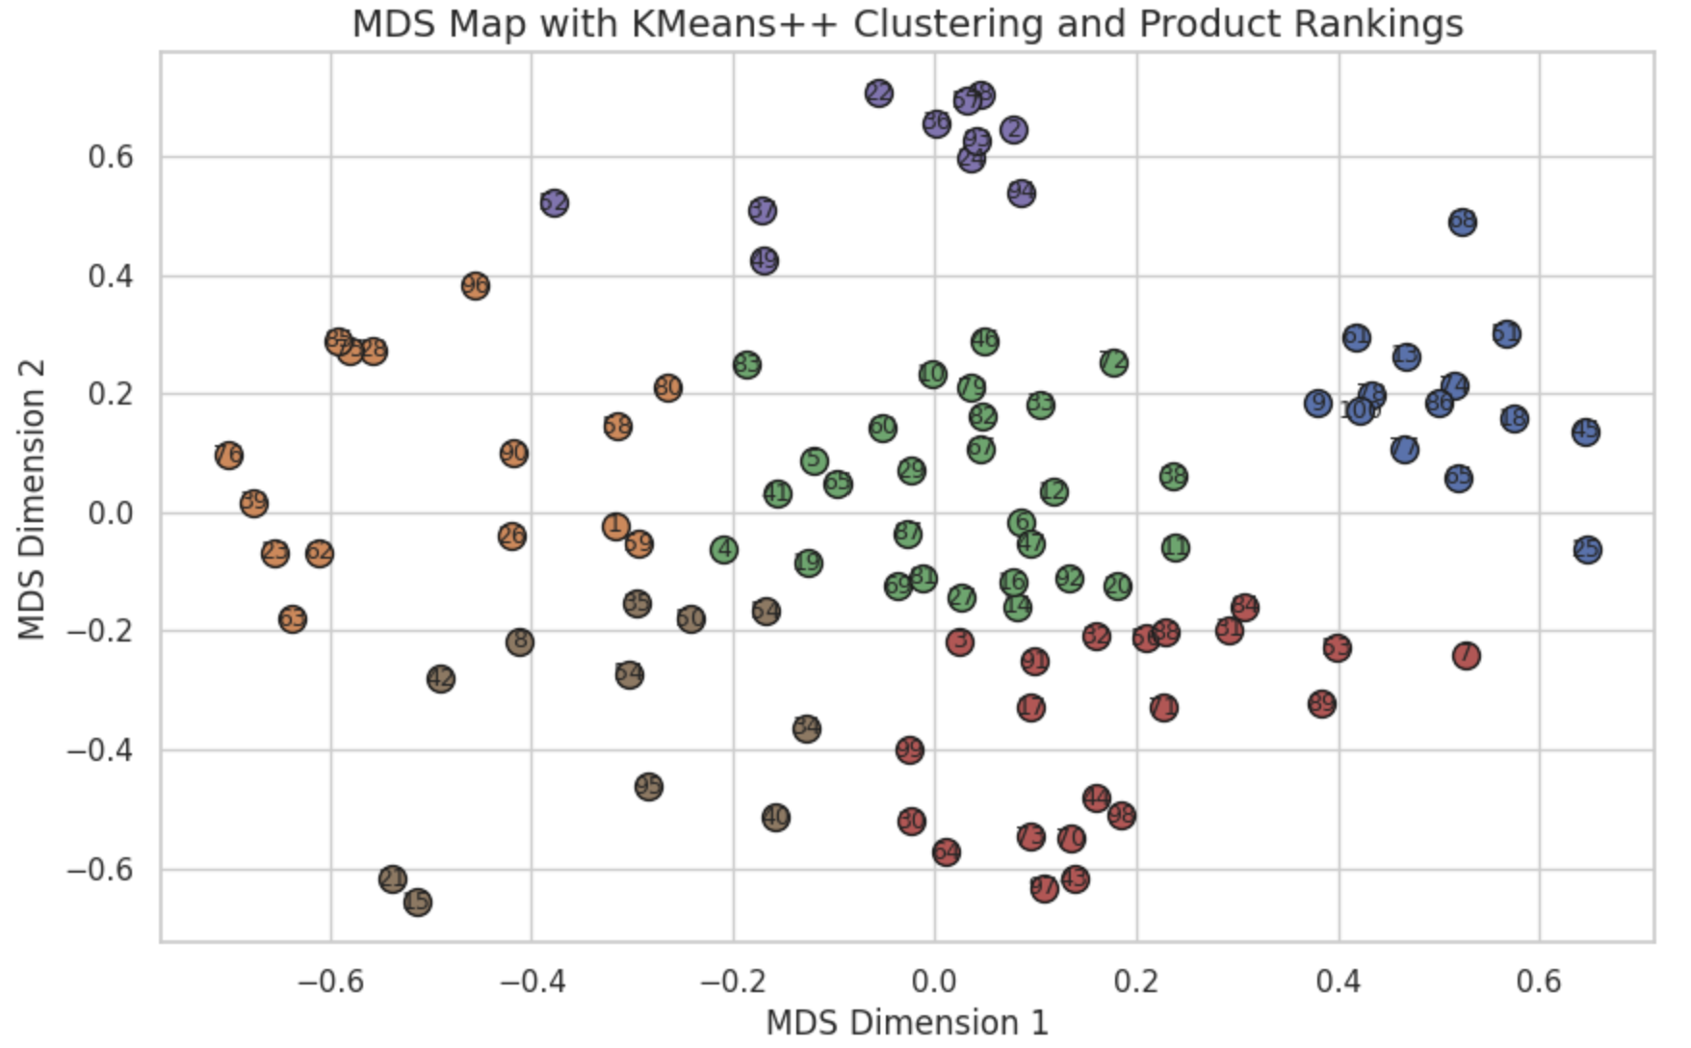
The Lather Latitude
Mapping the Shampoo Universe
Obtain product vectors based on how frequently a list of important attributes are talked about when reviewing a product
Based on the cosine similarity of various product vectors
Notes:
9 & 100 - Garnier Repairing Shampoo Honey Treasures & Maui Moisture Heal & Hydrate + Shea butter
2 & 93 - Head & Shoulders Classic Clean Anti Dandruff Shampoo & Dove Dryness & Itch Relief anti dandruff shampoo
1 & 69 - Garnier Sleek and Shine Intensely Smooth Leave In conditioning & Garnier Smoothing Shampoo with Coconut Oil & Cocoa butter extracts

Slide 12
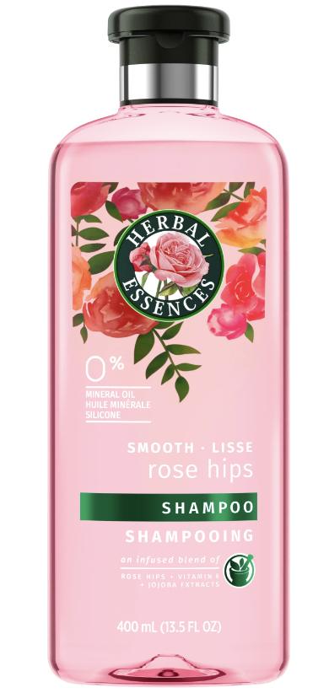
Profile 5: Need a Substitute?
Suppose you’re a long time fan of the Herbal Essences Smooth Collection Shampoo ($ 15.99), but you want to shake things up.
You need a new product with similar strengths!
From Other Brands
From Herbal Essences
Pantene Pro-V Classic Clean Shampoo
$ 10.99
Herbal Essences Color Me Happy Shampoo for Color Treated Hair $ 69.99
Tea Tree Special Shampoo
$ 16
Herbal Essences Bio:Renew Refresh Blue Ginger & Micellar Water Shampoo $6.99
Suave Professionals Rosemary + Mint Shampoo
$ 8.99
Herbal Essences Argan Oil of Morocco Shampoo
$ 10.95

Slide 13
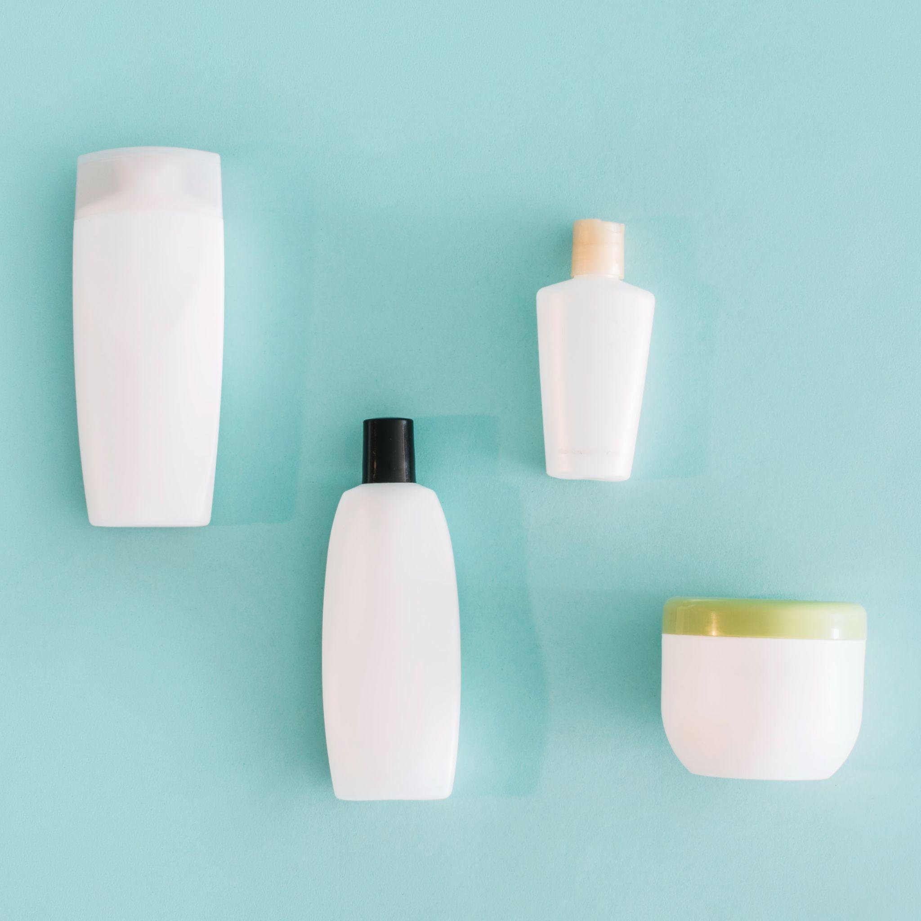
Future Work
Find more standard pricing data
Customer Segmentation: assist brands with launching new products
Market Basket Analysis: product bundling recommendations
Symptom Based Recommendations: For example, dandruff, itchiness, brassy hair color

Slide 14
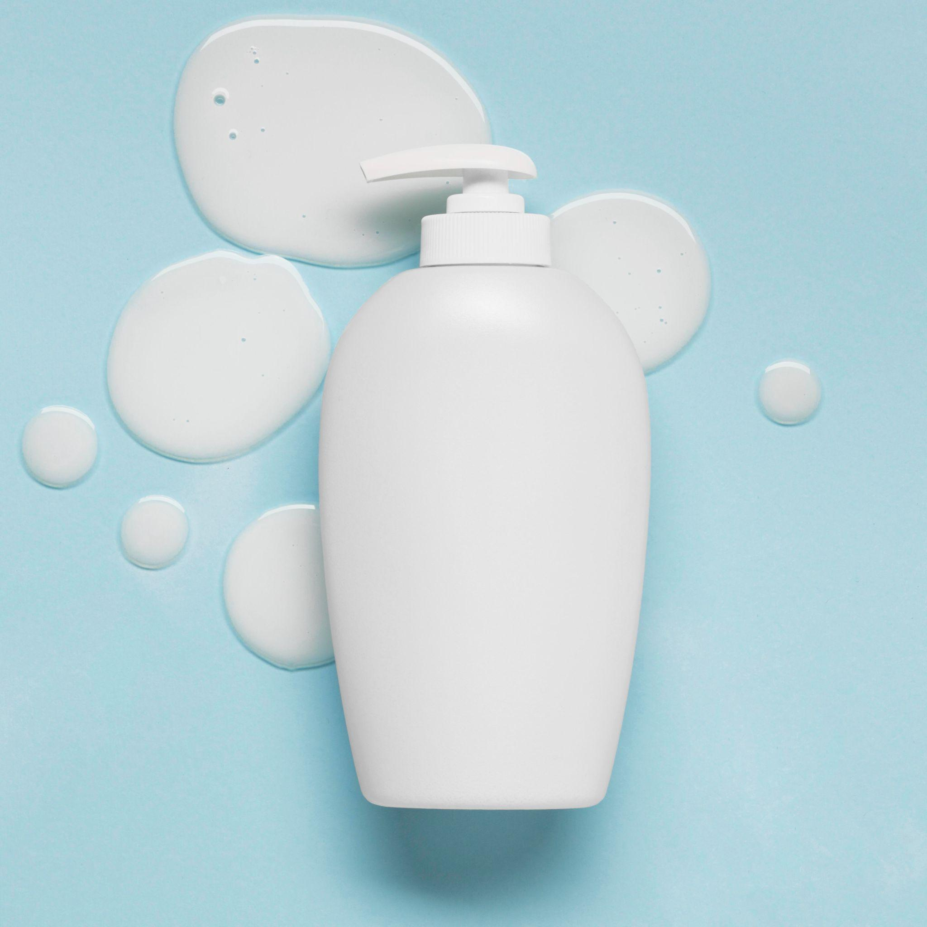
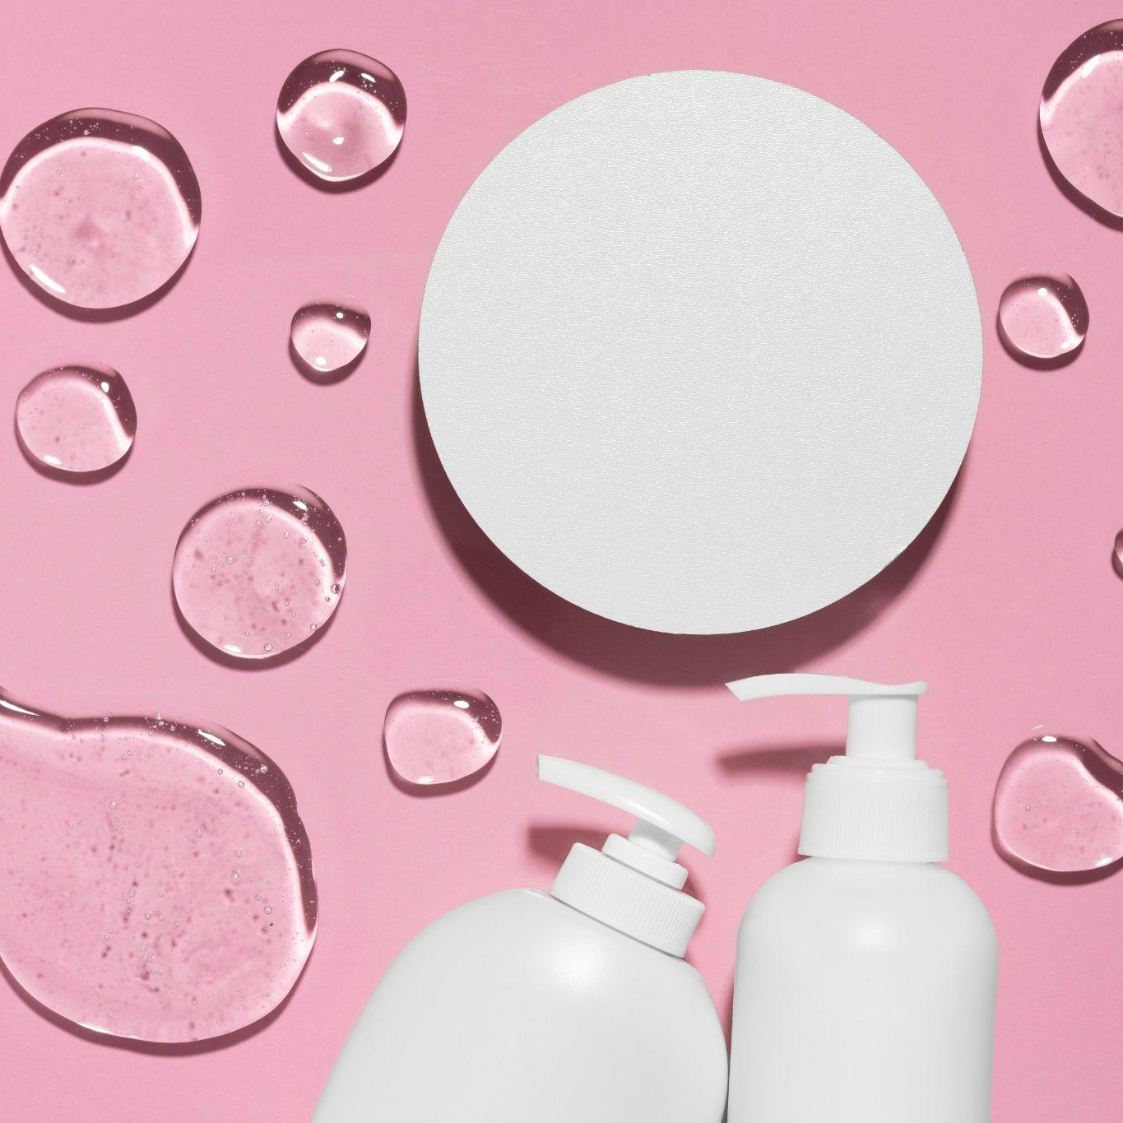
Thank you!
Questions?

Slide 15
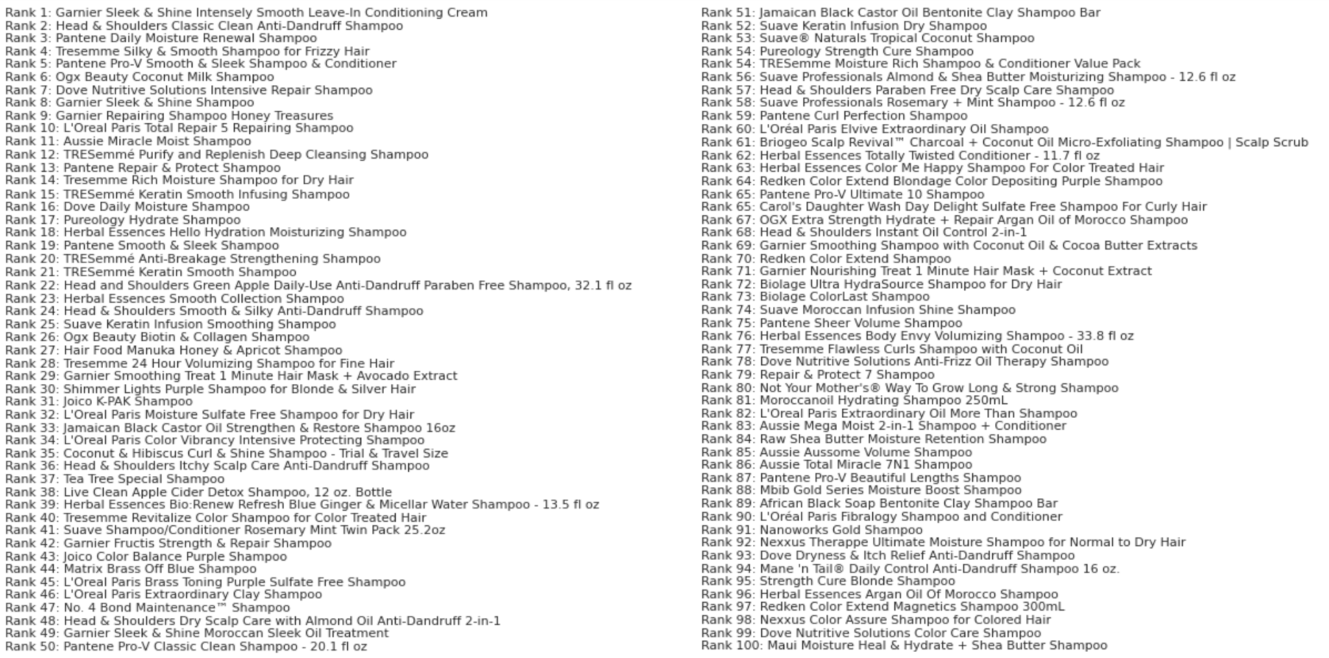
Appendix
OUR COMPANY
You can enter a subtitle here if you need it

